Slide 1
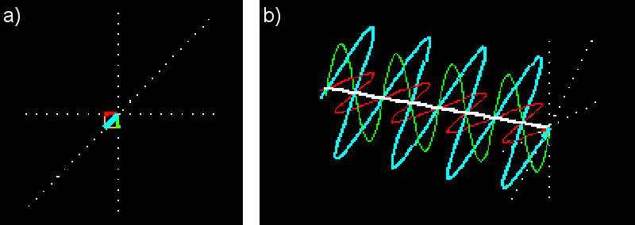
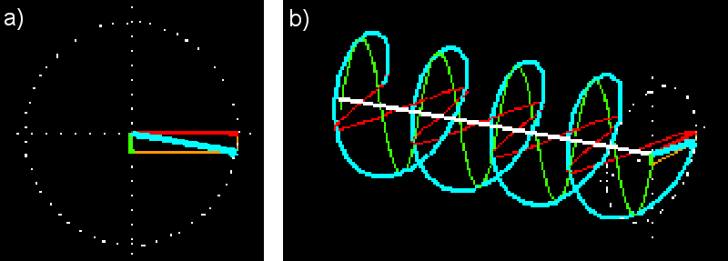
Polarizations of light
Any light polarization can be represented by the superposition of two basic orthogonal polarizations.
Linear superposition:
The two basic polarizations :
two perpendicular linearly polarized waves (red & green)

Slide 2
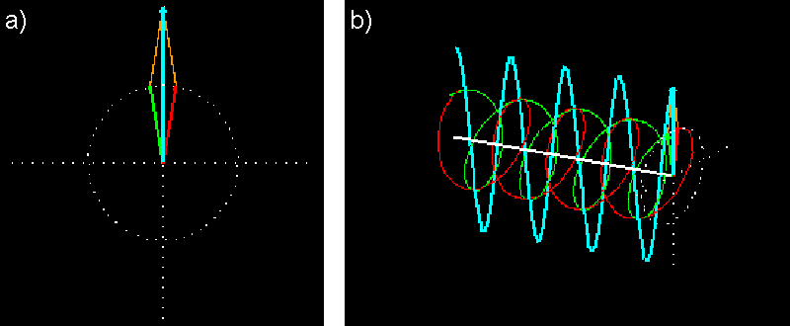
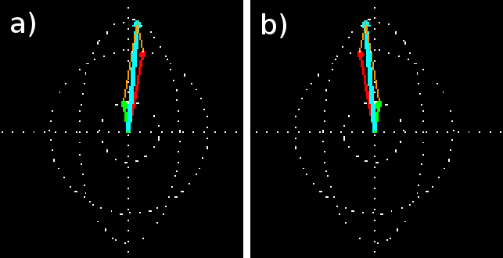
Polarizations of light
Circular superposition:
The two basic polarizations:
the left- and right-circularly polarized wave ( red & green)

Slide 3
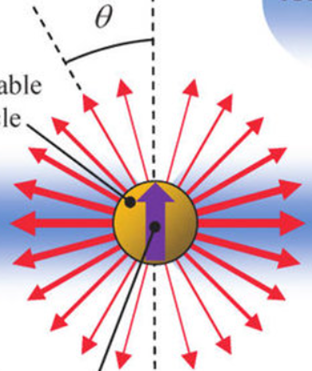
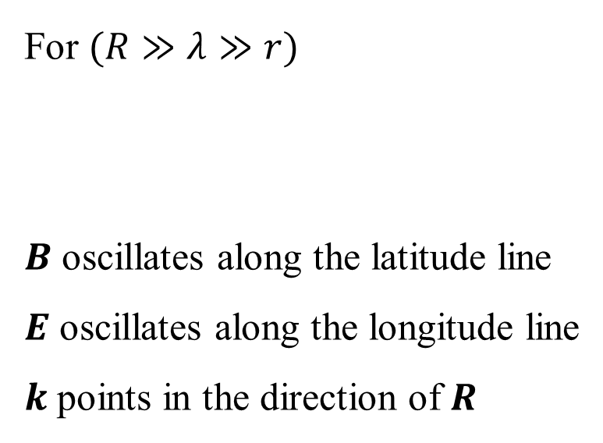

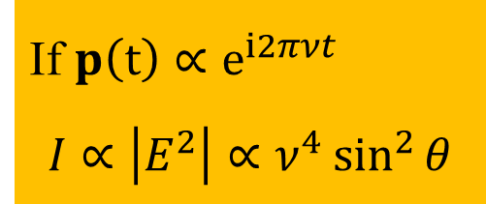
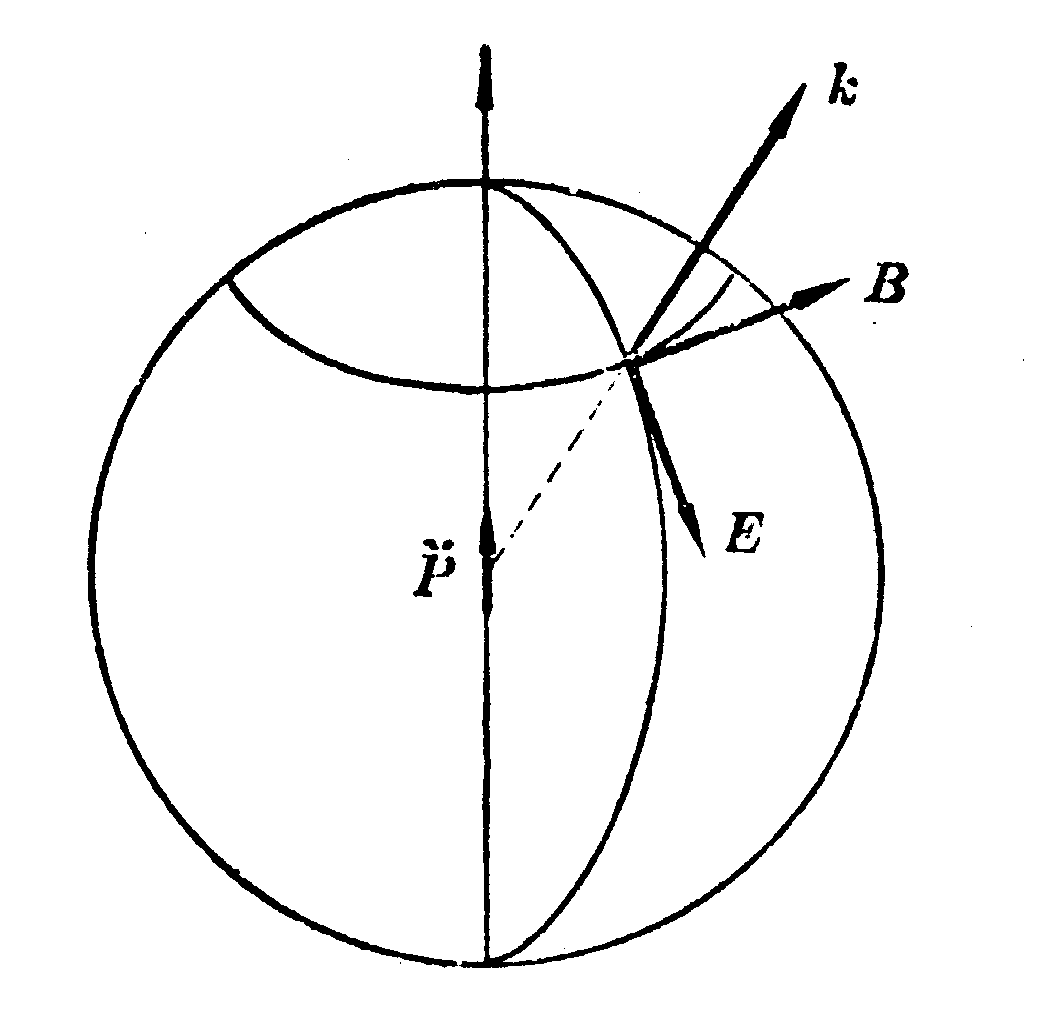
Dipole radiation
Electric Dipole: $p=qr r\left(t\right):displacement of the charge at time t$
A vibrating charge induces vibrating E&M field at distance $R$
For $(R≫λ≫r)$
$B$ oscillates along the latitude line
$E$ oscillates along the longitude line
$k$ points in the direction of $R$
$$R$$
If $p\left(t\right)∝e^{i2πνt}$
$$I∝\left|E^{2}\right|∝ν^{4}\sin^{2}{θ}$$

Slide 4
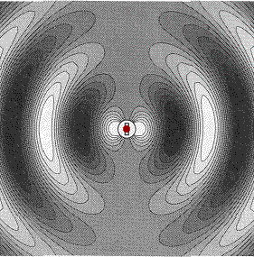
Dipole radiation
Electric Dipole: $p=qr r\left(t\right):displacement of the charge at time t$
A vibrating charge induces vibrating E&M field at distance $R$
For $(R≫λ≫r)$
$B$ oscillates along the latitude line
$E$ oscillates along the longitude line
$k$ points in the direction of $R$
$$R$$
If $p\left(t\right)∝e^{i2πνt}$
$$I∝\left|E^{2}\right|∝ν^{4}\sin^{2}{θ}$$

Slide 5
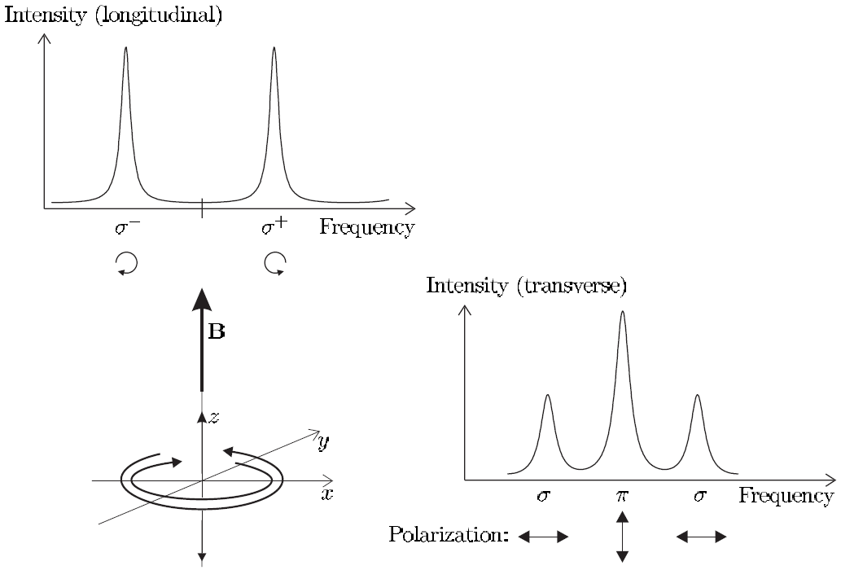

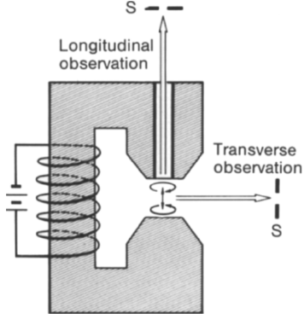
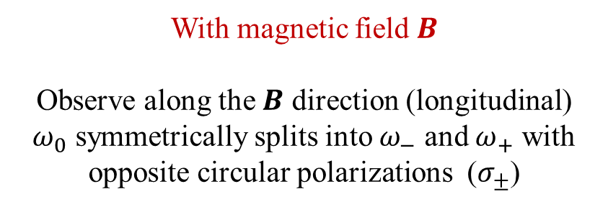

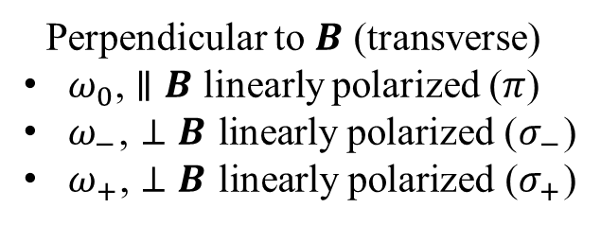

Zeeman effect（1896）and its classical (Lorentz) explanation
No magnetic field: unpolarized fluorescence of frequency $ω_{0}$ is observed from any direction.
With magnetic field $B$
Observe along the $B$ direction (longitudinal)
$ω_{0}$ symmetrically splits into $ω_{−}$ and $ω_{+}$ with opposite circular polarizations ($σ_{±}$)
Perpendicular to $B$ (transverse)
$ω_{0}$, $∥B$ linearly polarized ($π$)
$ω_{−}$, $⊥B$ linearly polarized ($σ_{−}$)
$ω_{+}$, $⊥B$ linearly polarized ($σ_{+}$)
$$σ^{−}$$
$$σ^{+}$$

Slide 6
Zeeman effect（1896）and its classical (Lorentz) explanation
No magnetic field: unpolarized fluorescence of frequency $ω_{0}$ is observed from any direction.
With magnetic field $B$
Observe along the $B$ direction (longitudinal)
$ω_{0}$ symmetrically splits into $ω_{−}$ and $ω_{+}$ with opposite circular polarizations ($σ_{±}$)
Perpendicular to $B$ (transverse)
$ω_{0}$, $∥B$ linearly polarized ($π$)
$ω_{−}$, $⊥B$ linearly polarized ($σ_{−}$)
$ω_{+}$, $⊥B$ linearly polarized ($σ_{+}$)
$$σ^{−}$$
$$σ^{+}$$

Slide 7
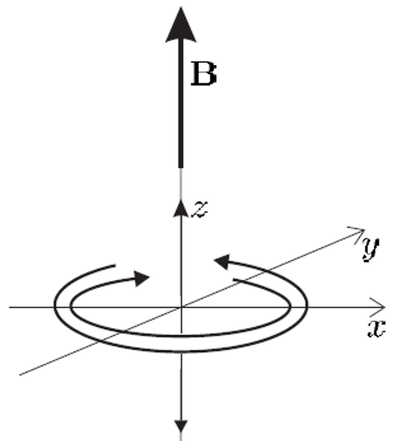
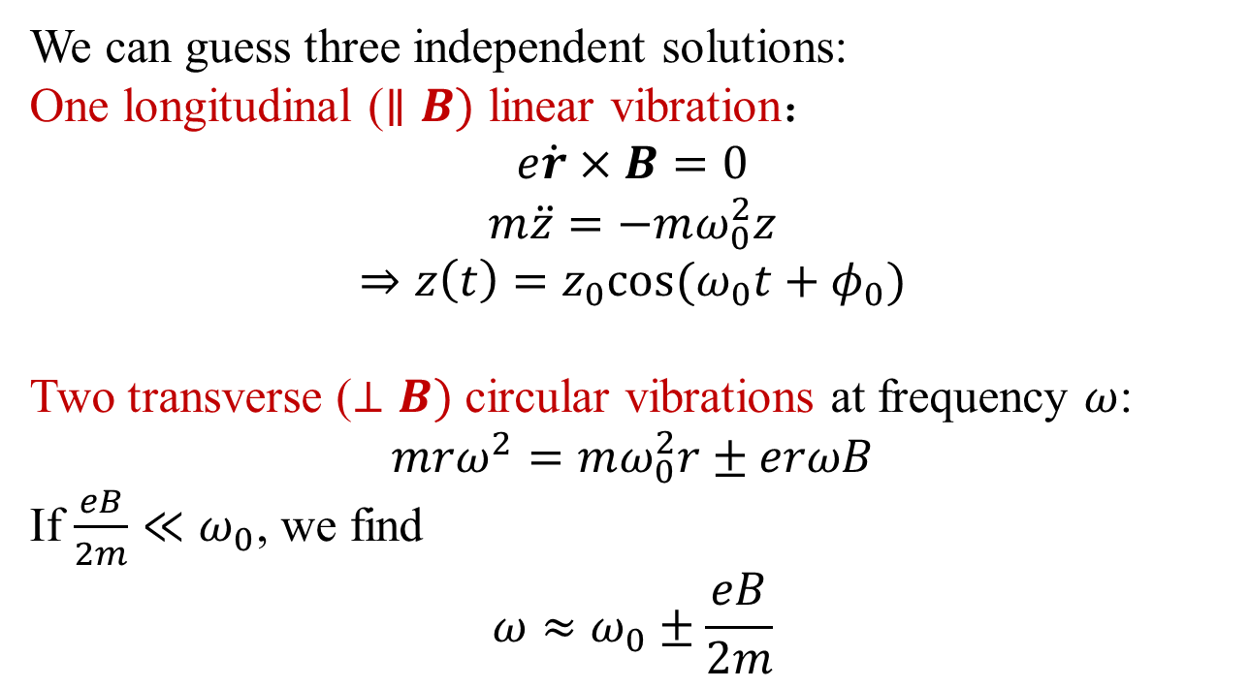
Lorentz equation:
We can guess three independent solutions:
One longitudinal ($∥B)$ linear vibration：
$$e\dot{r}×B=0$$
$$m\ddot{z}=−mω_{0}^{2}z$$
$$⇒z\left(t\right)=z_{0}cos⁡(ω_{0}t+φ_{0})$$
Two transverse ($⊥B)$ circular vibrations at frequency $ω$:
$$mrω^{2}=mω_{0}^{2}r±erωB$$
If $\frac{eB}{2m}≪ω_{0}$, we find
$$ω≈ω_{0}±\frac{eB}{2m}$$
Any kind of vibration is equal to the superposition of these three eigen-vibrations.
E&M radiations generated by these three eigen-vibrations of electron give rise to the Zeeman effect.

Slide 8
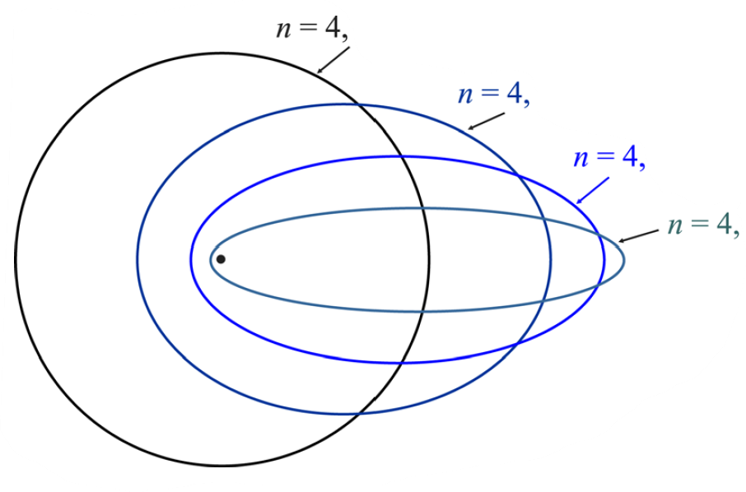
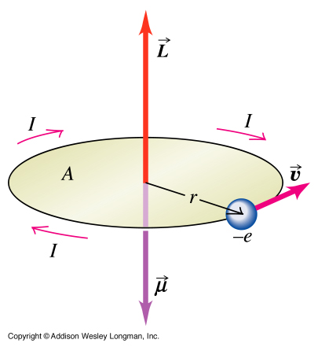
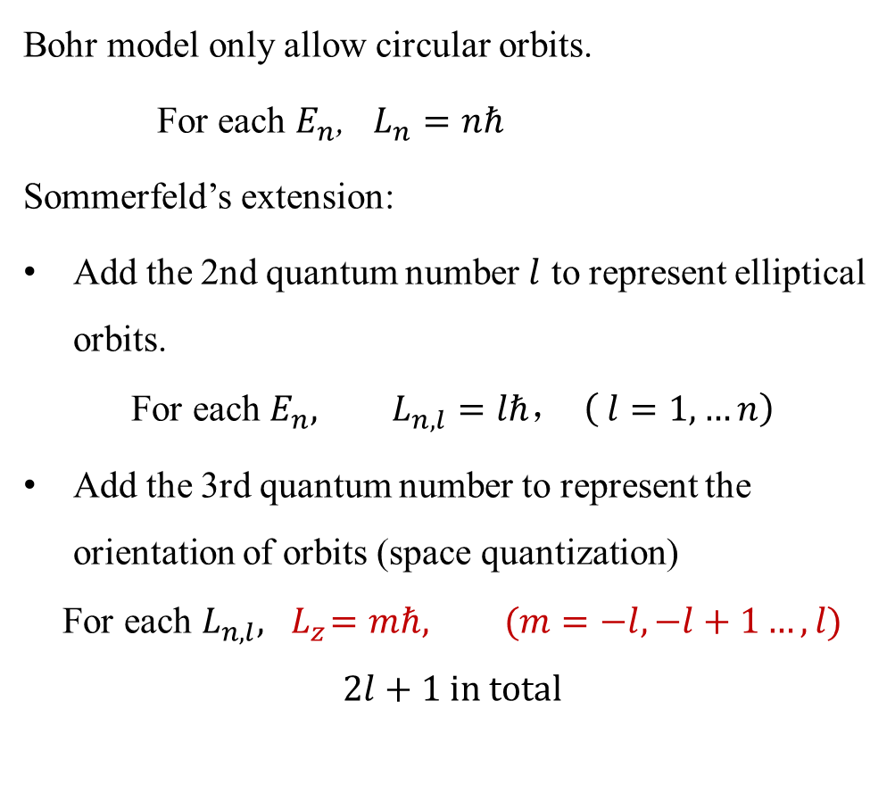
*Bohr-Sommerfeld (old) quantum theory
Bohr model only allow circular orbits.
For each $E_{n}$, $L_{n}=nℏ$
Sommerfeld’s extension:
Add the 2nd quantum number $l$ to represent elliptical orbits.
$$\text{For} \text{each} E_{n}, L_{n, l}=lℏ， \left( l=1,…n\right)$$
Add the 3rd quantum number to represent the orientation of orbits (space quantization)
$$\text{For} \text{each} L_{n,l}, { L}_{z}=mℏ, (m=−l,−l+1…,l)$$
$$2l+1 in total$$

Slide 9

Normal Zeeman effect explained by Bohr-Sommerfeld model
Electronic circular motion induces an orbital magnetic moment $μ$
The potential energy of $μ$ in $B$
Notes:
这个电子的圆周运动来自库伦相互作用，库仑力远大于磁场的洛伦兹力。因此我们可以认为电子的角动量的大小和磁场无关！

Slide 10
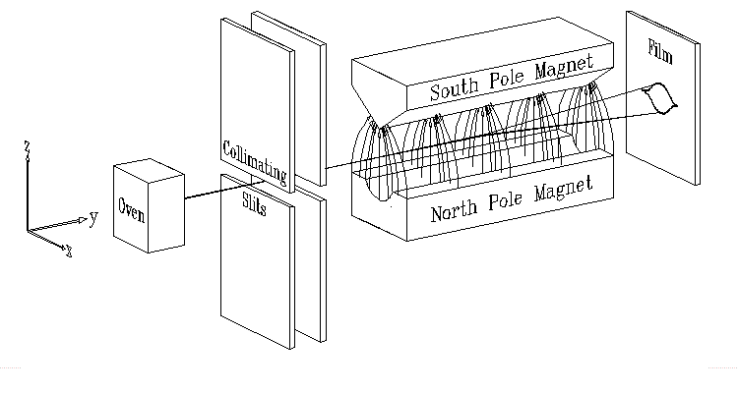
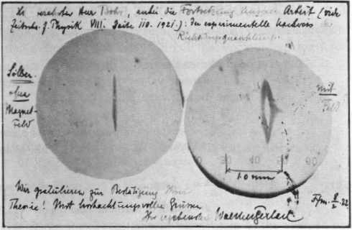
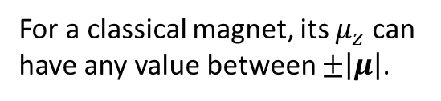

Stern-Gerlach experiment（1922）
Test of orientation quantization
Silver atoms
Postcard from Gerlach to Bohr:
“Attached is a direct evidence of the space quantization. Congratulations! Your theory is confirmed.”
$U=−μ⋅B=−μ_{z}B$
$F_{z}=−\frac{∂U}{∂z}=μ_{z}\frac{∂B}{∂z}$
$=−γmℏ\frac{∂B}{∂z}, m=±1$
For a classical magnet, its $μ_{z}$can have any value between $±\left|μ\right|$.
Notes:
This convinced me once and for all that an ingenious classical mechanism was out and that we had to face the fact that the quantum phenomena required a completely new orientation. – I.I.Rabi

Slide 11

Interpretation of the Stern-Gerlach experiment
Confirmed the orientation (space) quantization of angular momentum.
Why there are two stripes instead of three?
$$m=±1 \text{instead} \text{of} m=0,±1$$

Slide 12
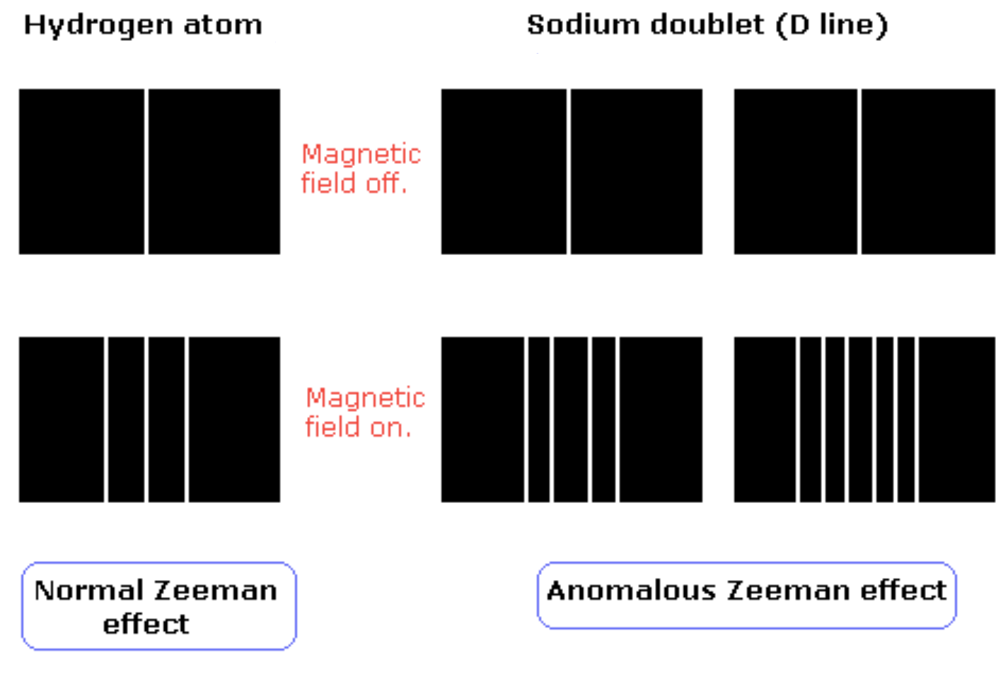
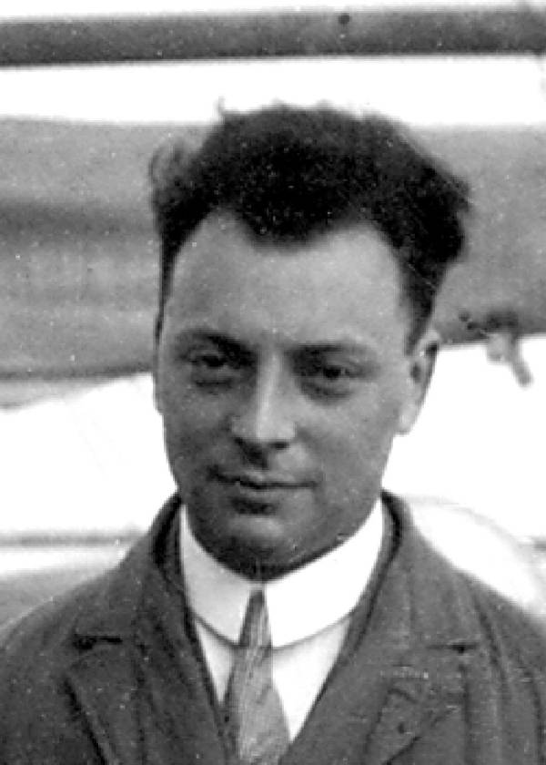
Anomalous Zeeman effect
‘How can one look happy when he is thinking about the anomalous Zeeman effect?’ ——Pauli

Slide 13
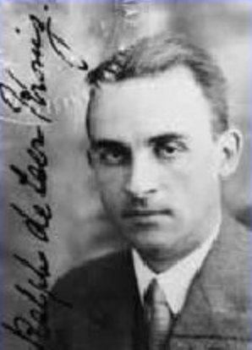
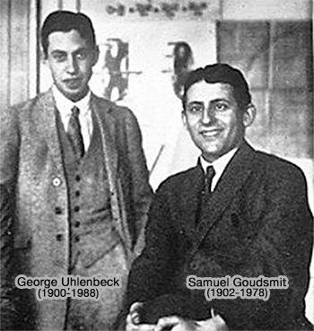
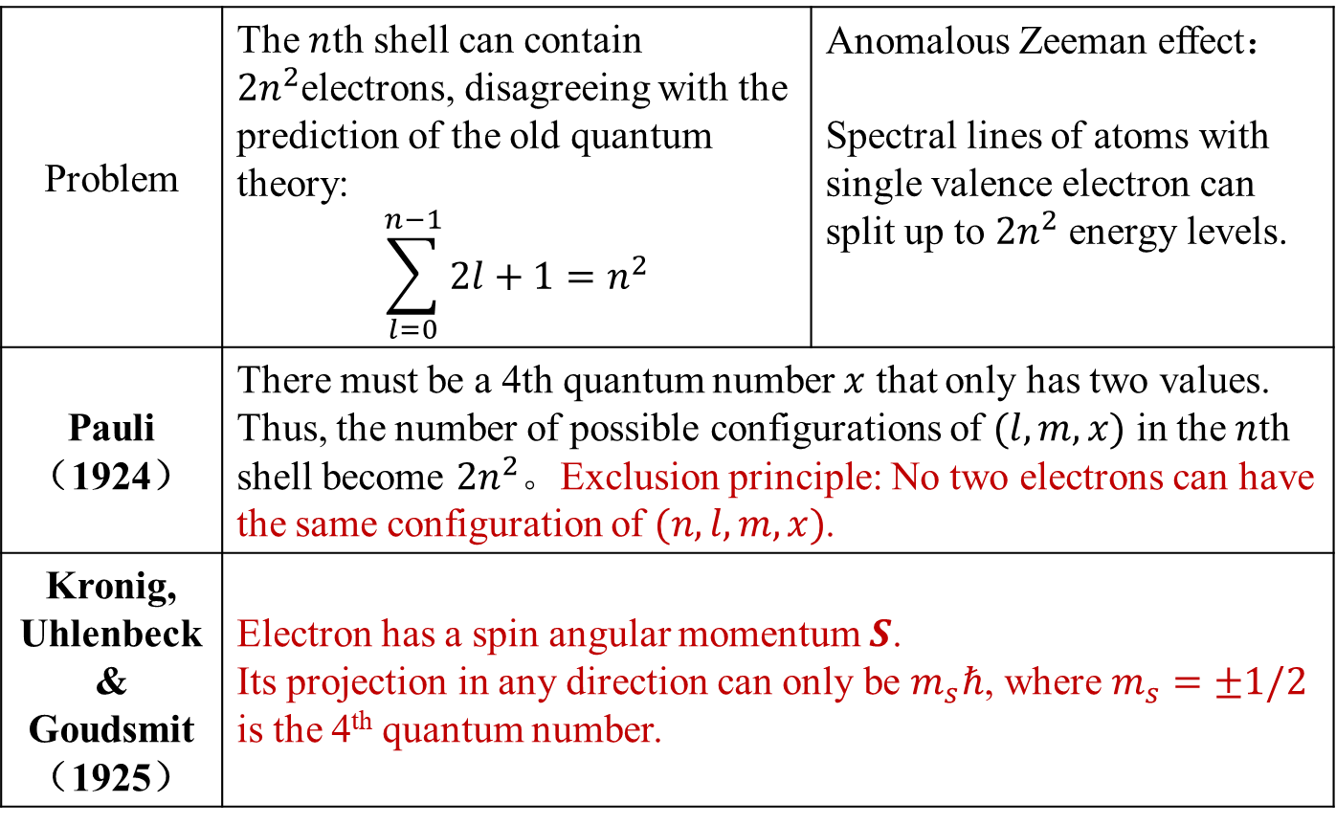
Pauli’s exclusion principle and electron spin（1925）
Problem | The $n$th shell can contain $2n^{2}$electrons, disagreeing with the prediction of the old quantum theory: $$\sum_{l=0}^{n−1}{2l+1}=n^{2}$$ | Anomalous Zeeman effect： Spectral lines of atoms with single valence electron can split up to $2n^{2}$ energy levels.
Pauli （1924） | There must be a 4th quantum number $x$ that only has two values. Thus, the number of possible configurations of $(l,m,x)$ in the $n$th shell become $2n^{2}$。Exclusion principle: No two electrons can have the same configuration of $(n,l,m,x)$.
Kronig, Uhlenbeck & Goudsmit （1925） | Electron has a spin angular momentum $S$. Its projection in any direction can only be $m_{s}ℏ$, where $m_{s}=±1/2$ is the 4th quantum number.
Kronig
Notes:
There was a sense of crisis. The state of physics ‘was from a methodological point of view, a lamentable hodgepodge of hypothesis, principles, theorems, and computational recipes rather than a logical, consistent theory.
Progress was often based on artful guessing and intuition rather than scientific reasoning.
That spring, it seemed that only a quantum magician could conjure up the yearned-for ‘new’ quantum theory – quantum mechanics.

Slide 14
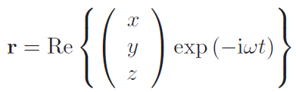
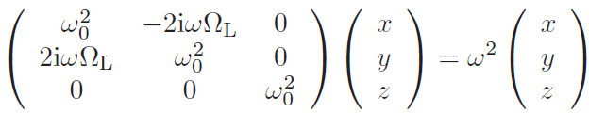


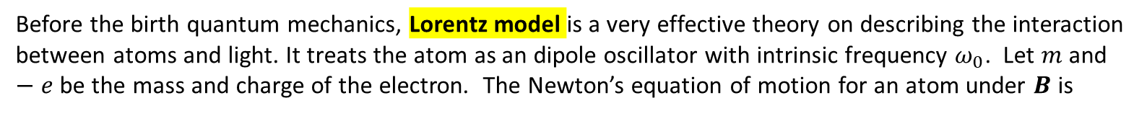

*Classical explanations of the Zeeman effect
  Before the birth quantum mechanics, Lorentz model is a very effective theory on describing the interaction between atoms and light. It treats the atom as an dipole oscillator with intrinsic frequency $ω_{0}$. Let $m$ and $−e$ be the mass and charge of the electron. The Newton’s equation of motion for an atom under $B$ is
$$r$$
$$F=−m_{e}ω_{0}^{2}r$$
  Assume $B=B\hat{z}$, we have
The evolution of $r$ should be periodic. We make an ansatz：
where $x,y,z$ are time independent complex numbers. Applying the ansatz in the equation of motion, we obtain the following set of linear differential equations
For $Ω_{L}≪ω_{0}$, we obtain 3 eigenvalue solutions for $ω: ω_{0}−Ω_{L}, ω_{0},ω_{0}+Ω_{L}$
Notes:
Anzatz：an educated guess

Slide 15
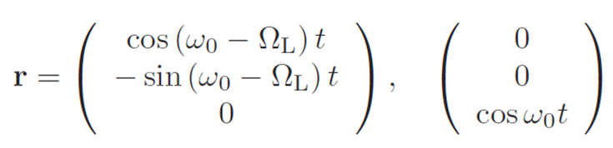
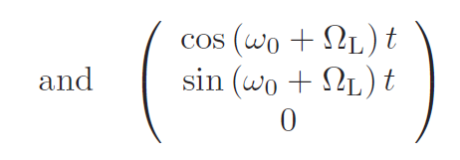
*Classical explanations of the Zeeman effect
These 3 eigenvalues $ω_{0}−Ω_{L}, ω_{0}, ω_{0}+Ω_{L}$ correspond to 3 eigenmodes of oscillations:
The graphical representation of these 3 eigenmodes of oscillations.

Slide 16
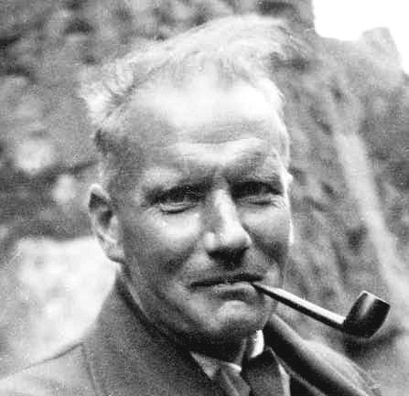
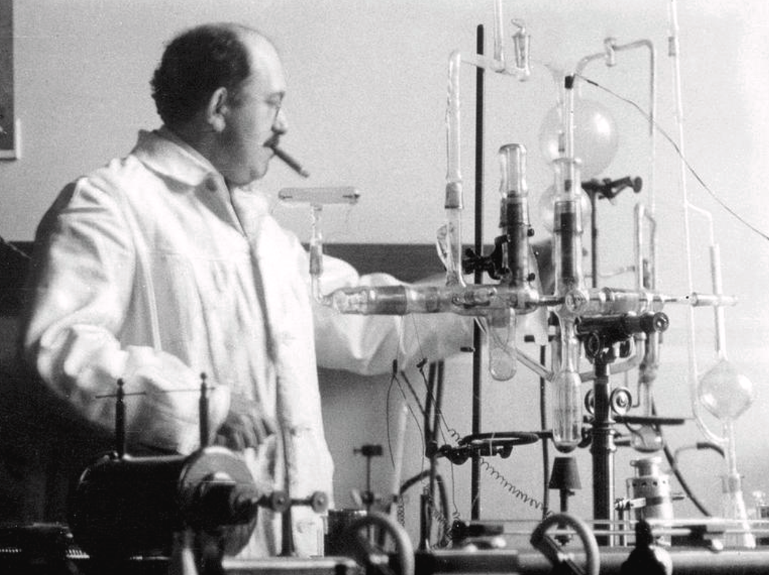
How a Bad Cigar Helped Reorient Atomic Physics
Walter Gerlach
http://scitation.aip.org/content/aip/magazine/physicstoday/article/56/12/10.1063/1.1650229
Otto Stern

Slide 17
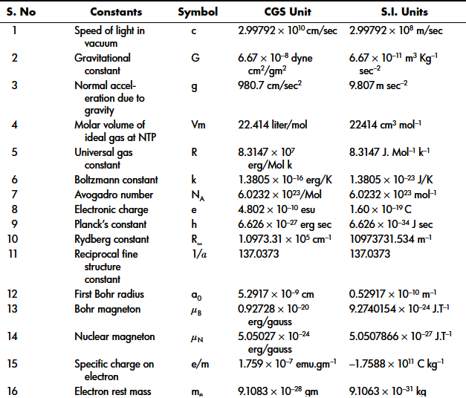
Table of constants

